Slide 1
A Survival Guide to WebSockets With Spring Boot
Stefan Balea

Slide 2
Agenda
HTTP and WebSocket protocols
Spring Boot with WebSocket
STOMP (Simple Text Oriented Messaging Protocol)
Spring Boot with STOMP
Handshake interceptor
Default Handshake handler
Channel interceptor
Error handling
Flow of messages
Simple Broker
Relay Broker
Conclusions
Q&A

Slide 3
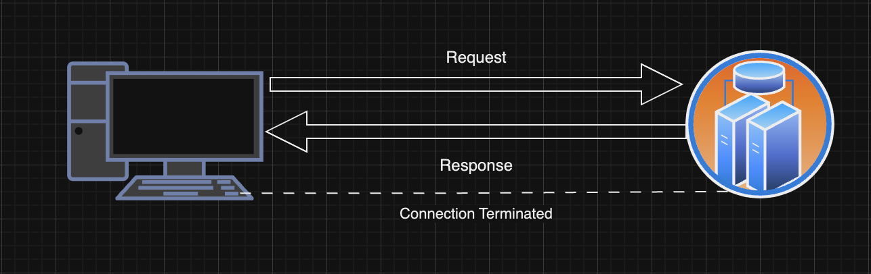
HTTP and WebSocket Protocols
protocols used in client-server communication
HTTP:
unidirectional communication from client to server
URI scheme: http or https
stateless protocol that runs on top of TCP
message information encoded in ASCII
each HTTP message information contains:
protocol version (HTTP/1.1 / HTTP/2)
http method (GET / POST / PUT / POST etc)
http headers (Content-Type, Content-Length, Accept)
host information
request body

Slide 4
HTTP and WebSocket Protocols
WebSocket:
bidirectional communication
URI scheme: ws or wss
stateful protocol
Client sends a HTTP GET request with the following headers
Connection: Upgrade
Upgrade: websocket
Sec-WebSocket-Key: one time random value base64 encoded
Sec-WebSocket-Version: 13 (allowed value at this moment)
If server allowed the connection, it will respond with the following headers
Response code: Http 101 Switching Protocols
Upgrade: websocket
Connection: Upgrade
Connection is switched to WebSocket

Slide 5
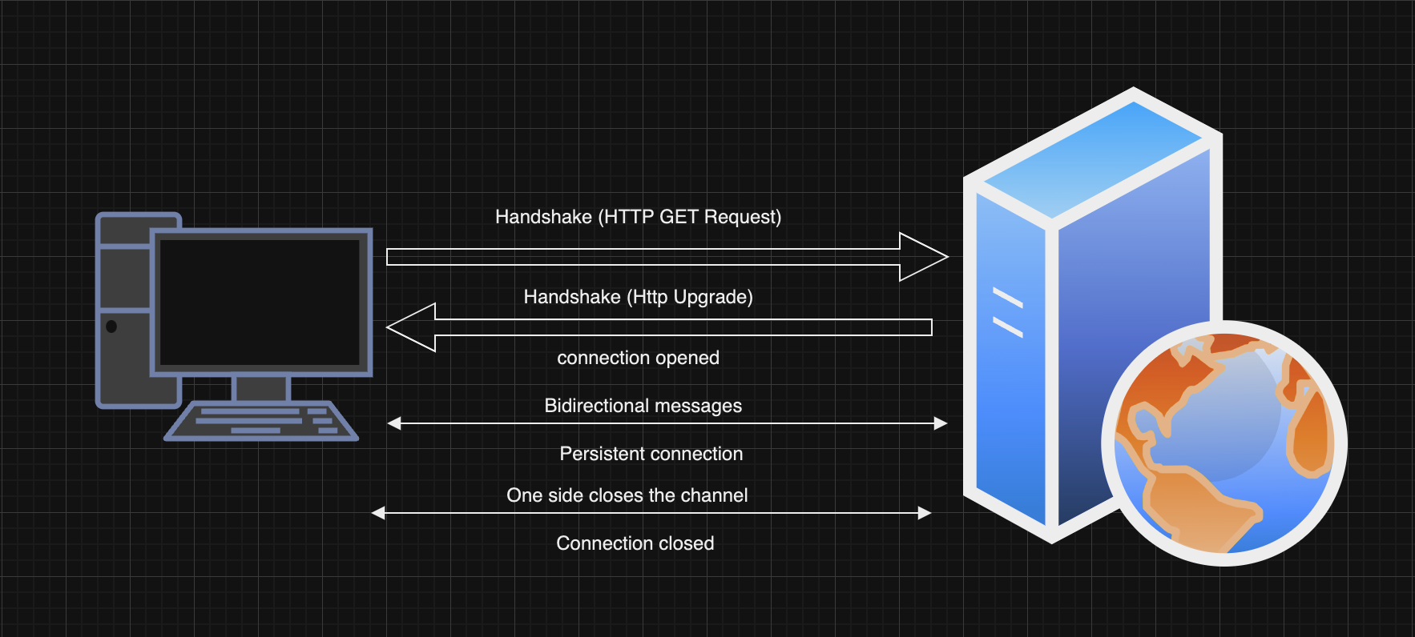
HTTP and WebSocket Protocols

Slide 6




WebSocket use cases
real time collaboration
chat applications (our case)
real time web applications
IoT devices

Slide 7
2. Spring Boot with WebSocket
Steps to implement:
add spring-boot-starter-websocket dependency
implement one of the existing handlers:
text: by extending TextWebSocketHandler class
binary: by extending BinaryWebSocketHandler class
create new WebSocketConfiguration class that implements WebSocketConfigurer
implement registerWebSocketHandlers method

Slide 8
Demo: Spring Boot with WebSocket

Slide 9
3. STOMP (Simple Text Oriented Messaging Protocol)
frame based protocol which assumes a reliable 2-way streaming network protocol
initially created for scripting languages like Ruby / Perl to connect to enterprise message brokers
communication between the client and the server will be done using frames
Frame components:
command
set of optional headers
optional body
COMMAND
header1:value1
header2:value2
Body^@

Slide 10
3. STOMP - Connecting
the client initiates the stream or TCP connection by sending a CONNECT frame
CONNECT
accept-version:1.2
host:stomp.company.com
^@
if the server accepts the connection, it will respond with CONNECTED frame
CONNECTED
session:unique-value
server:Apache/1.3.9
^@
Note: heartbeat information (using ‘heart-beat’ header) can be sent also by the client / server in order to check the healthiness of the connection

Slide 11
3. STOMP - Other Commands
sent by the client
SUBSCRIBE (subscribe to a desired destination, which can be a queue or a topic)
SEND (send a message to the desired destination)
UNSUBSCRIBE (unsubscribe from a desired destination)
DISCONNECT (disconnect from server)
sent by server
MESSAGE (send a message to the client)
ERROR (something goes wrong)

Slide 12
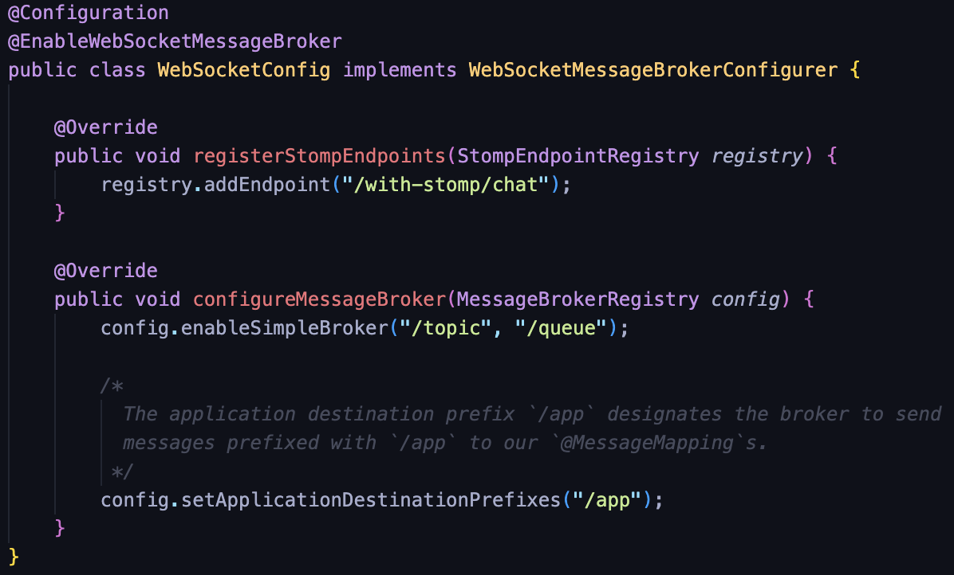
4. Spring Boot with STOMP
Steps to implement:
add spring-boot-starter-websocket dependency
create configuration class that implements WebSocketMessageBrokerConfigurer and implements at least the following two methods:
registerStompEndpoints
configureMessageBroker

Slide 13
4.1 Handshake interceptor
interceptor for handshake websocket request
used for inspecting the handshake request / response
check user authorization (by checking a particular query param or cookie)
Steps to implement:
create a new class that extends WebSocketHandshakeInterceptor
implement beforeHandshake and / or afterHandshake methods and implement desired logic
append any required information that is needed in next interceptors (using HttpSession)
register the interceptor using addInterceptor method in registerStompEndpoints method

Slide 14
4.2 Default Handshake handler
handler used for setting the User Principal on WebSocket session if the session should be authenticated
Steps to implement:
create a new class that extends DefaultHanshakeHandler
implement determineUser method and implement desired logic for setting the Principal
register the handler using setHandshakeHandler method in registerStompEndpoints method

Slide 15
4.3 Channel interceptor
interceptor for implementing additional logic at STOMP frames level (e.g: CONNECT / SUBSCRIBE)
Use case:
two available topics: /available-for-any-role, /available-for-admin-role
how to check if an authenticated user can subscribe to both?
Solution: an interceptor that will check when SUBSCRIBE frame is sent if the user has desired role or not.
Steps to implement:
create a new class that implements ChannelInterceptor and implement preSend method
register the interceptor in configureClientInboundChannel

Slide 16
4.4 Error handling
intercept current errors and return them in a standard format
Steps to implement:
create a new class that extends StompSubProtocolErrorHandler and implement handleInternal method
register the interceptor using setErrorHandler method in registerStompEndpoints method
CORS:
in order to restrict access, setAllowedOrigins method can be used in registerStompEndpoints method

Slide 17
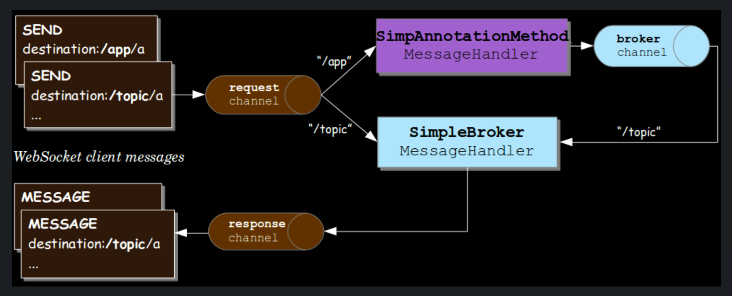
5.1 Flow of messages Simple Broker

Slide 18
Demo: Spring Boot with Simple Broker using one single instance

Slide 19
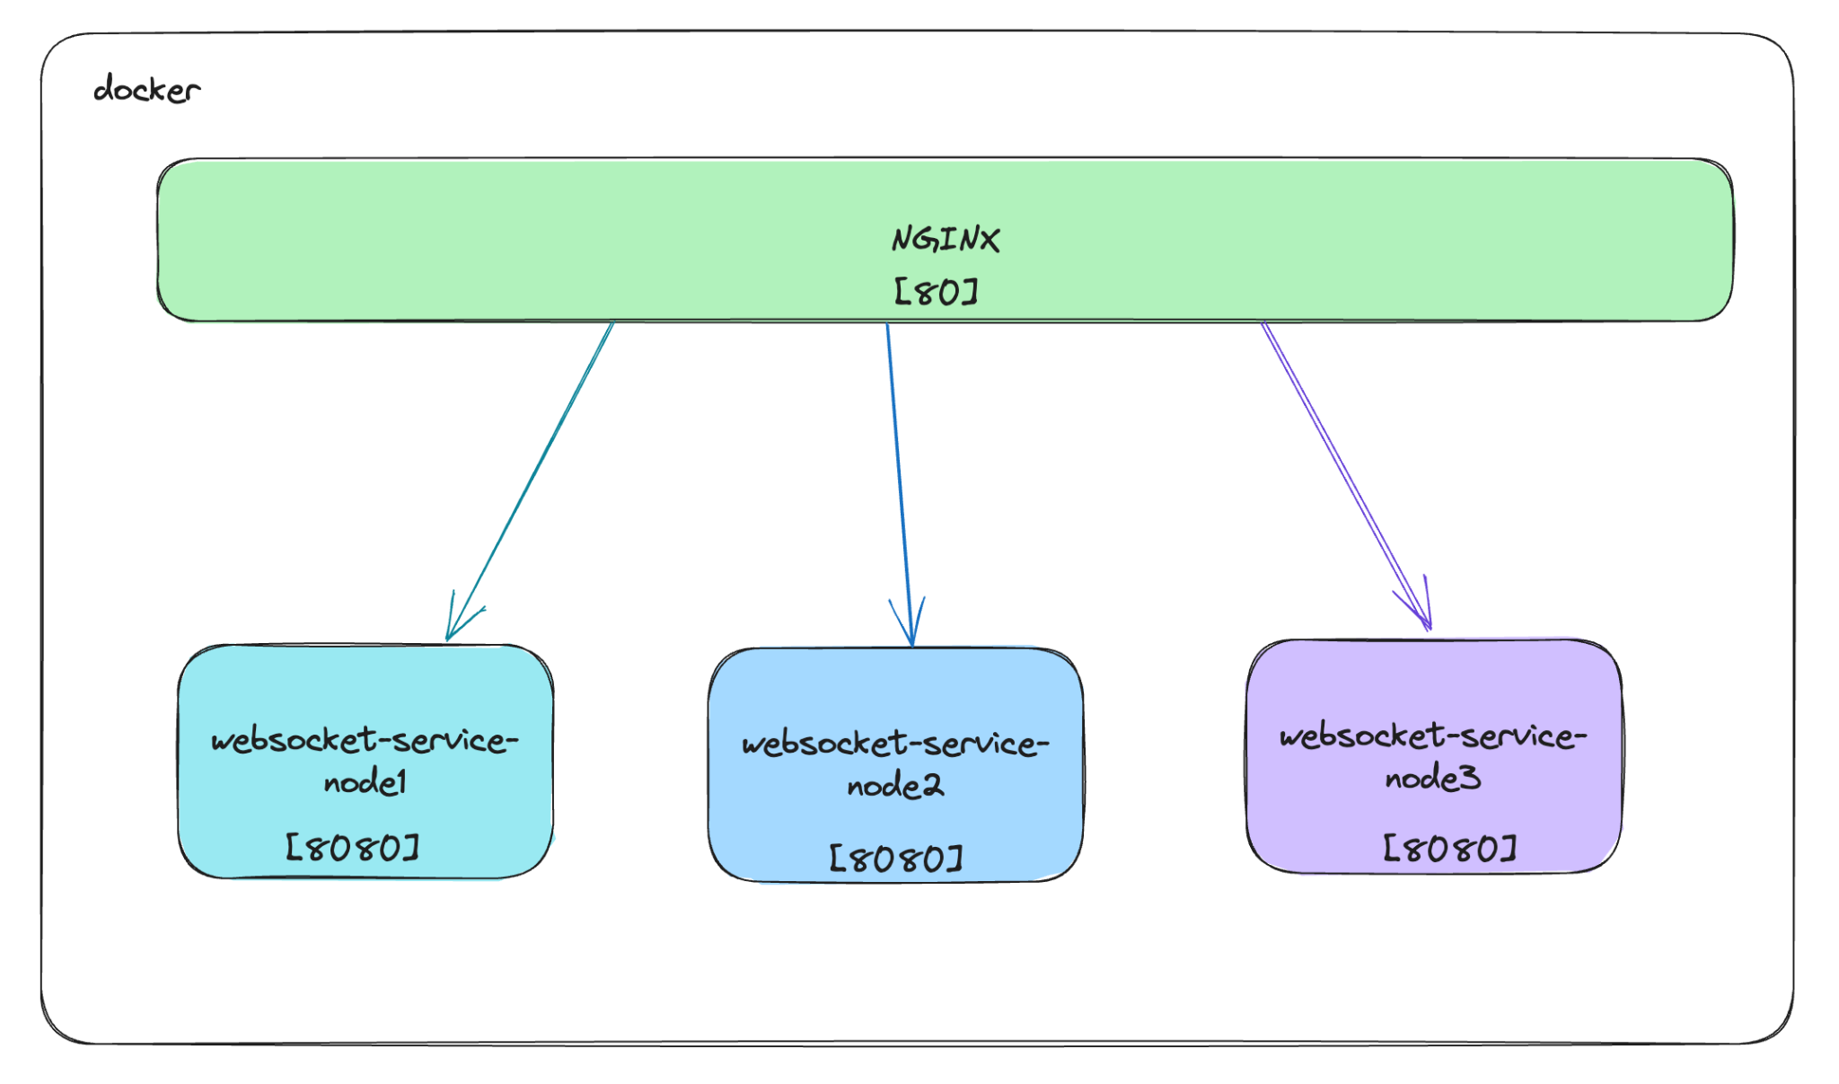
What happens if we want to scale the application?

Slide 20
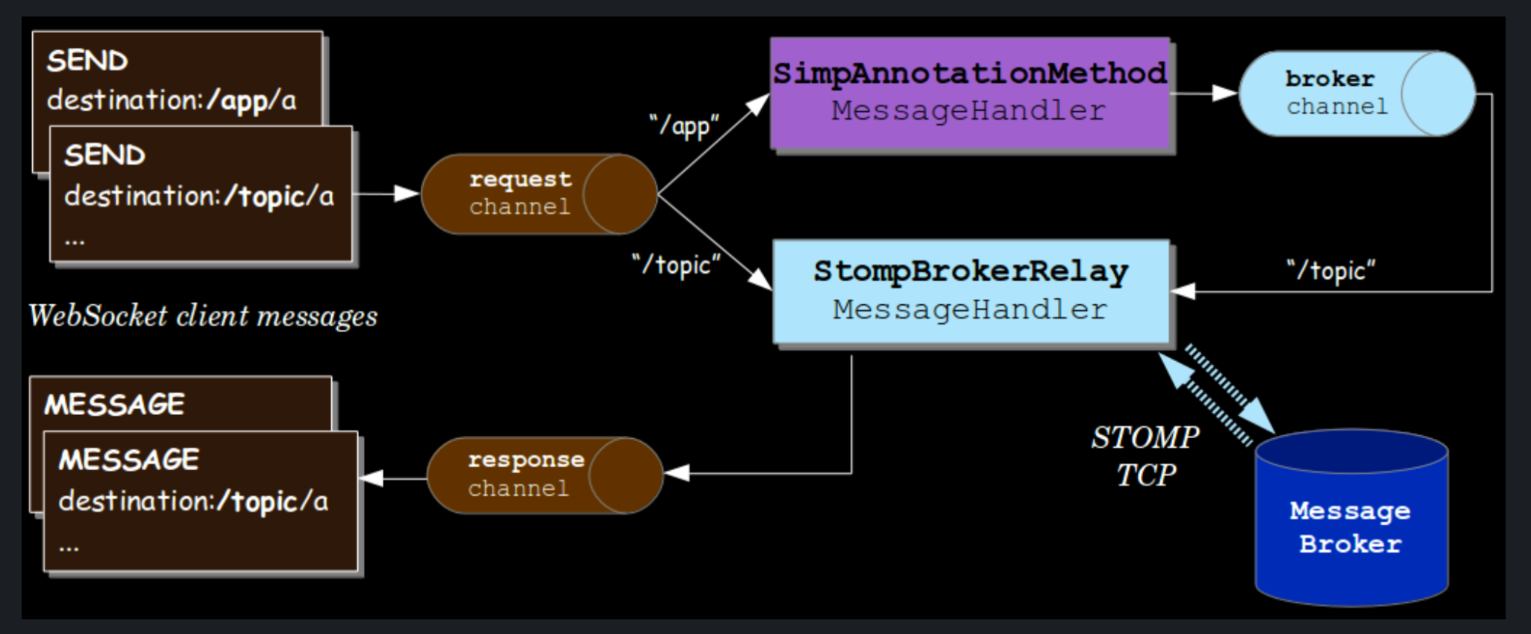
5.2 Flow of messages Broker Relay

Slide 21
Demo: Spring Boot with Broker Relay using one single app instance without broker failover

Slide 22
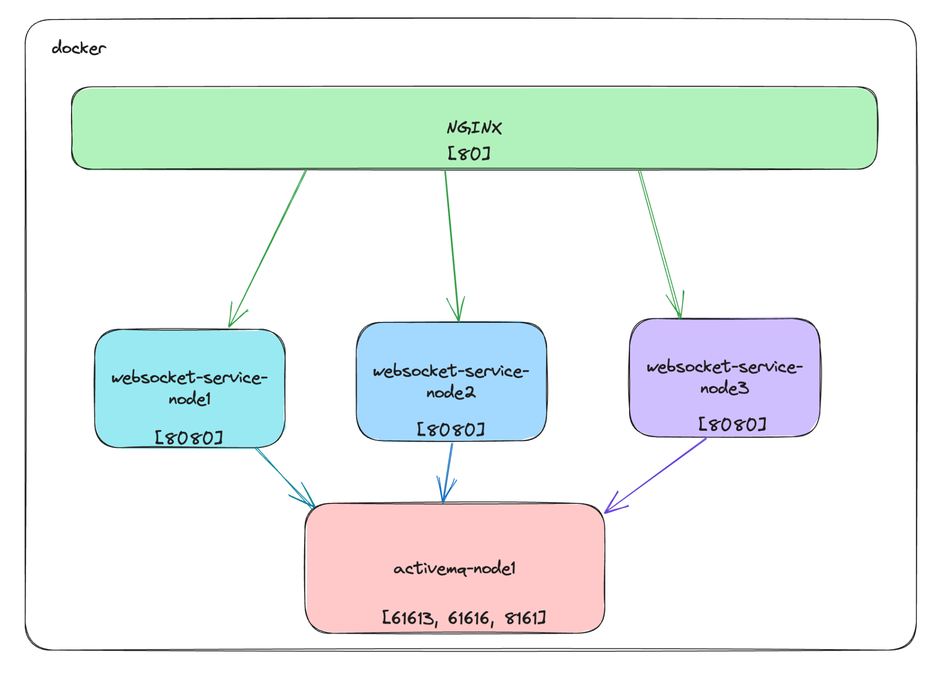
How we can scale up the system?

Slide 23
Demo: Spring Boot with Broker Relay using multiple instances without broker failover

Slide 24
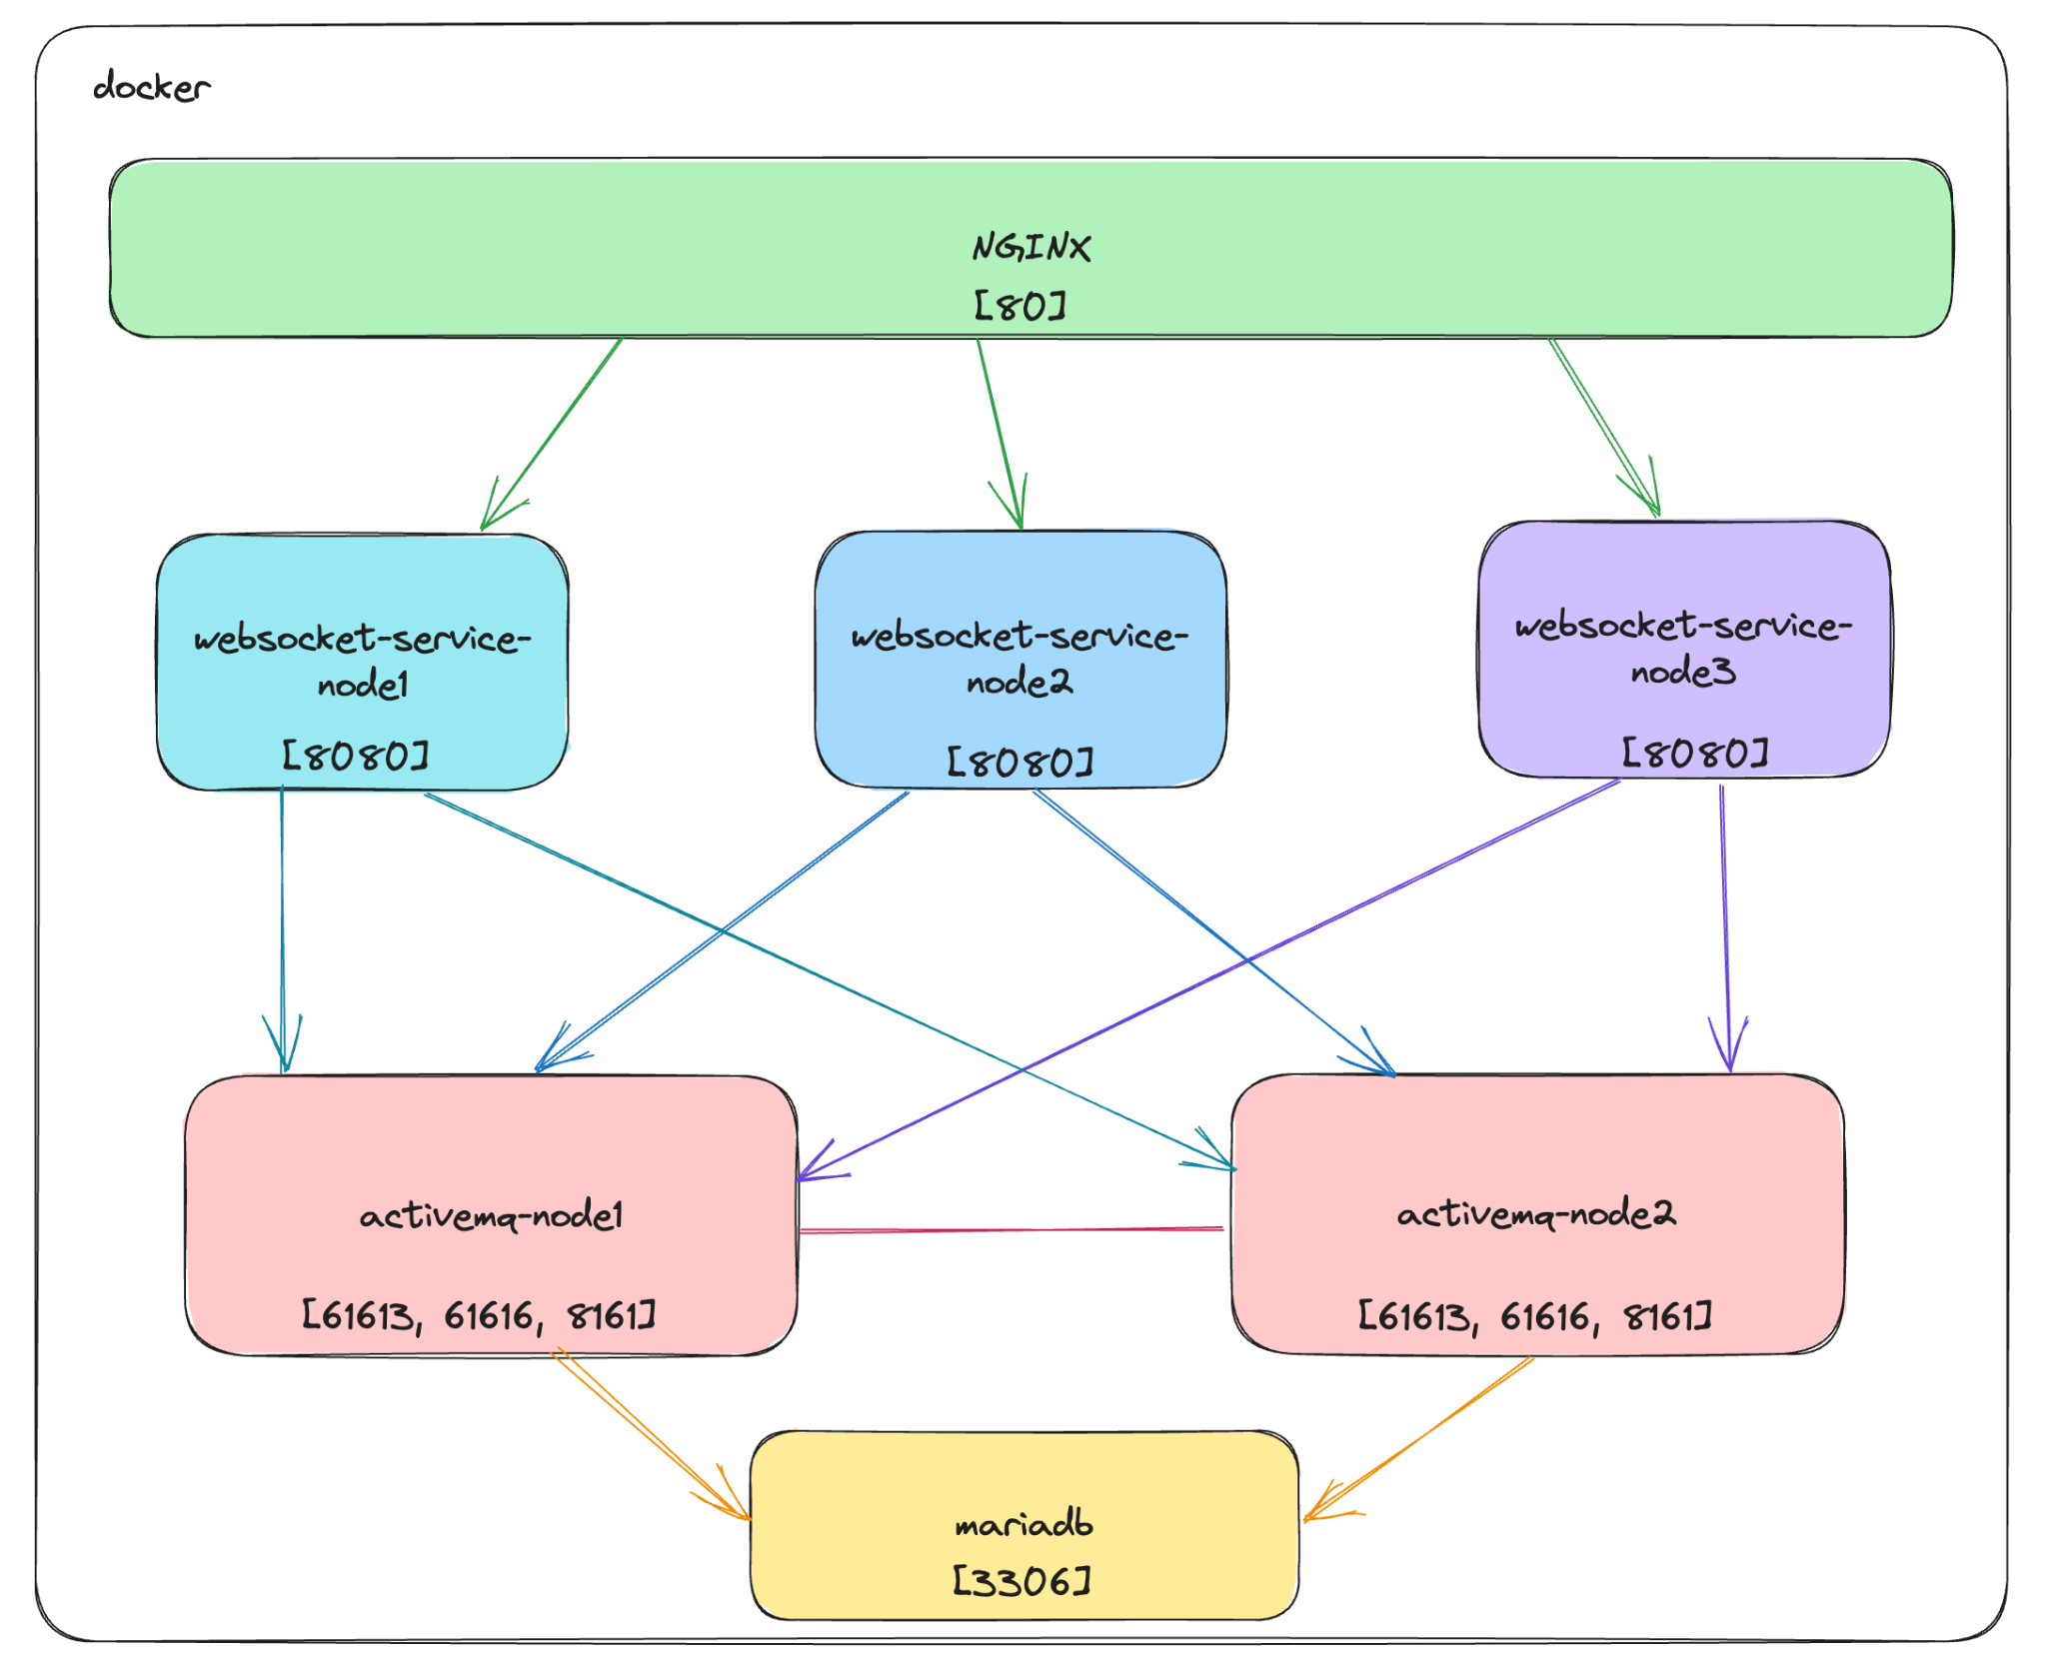
What happens if the broker relay server is down?

Slide 25
Demo: Spring Boot with Broker Relay using multiple instances with broker failover

Slide 26
6. Conclusions
WebSockets can be implemented in Spring Boot by:
using raw implementation (new handlers which extend one of the two default handlers: TextWebSocketHandler or BinaryWebSocketHandler)
using STOMP
with Simple Broker
with Relay Broker
Other improvements (for ActiveMQ):
transport tuning in ActiveMq (switch to nio transport, adjust thread pools etc)
traffic partitioning in ActiveMQ

Slide 27

7. Q&A

